Slide 1

Unit 16 – Procedural Programming
with Ben Read

Slide 2
AIMS & OBJECTIVES
Understand the importance of modularity
Investigate the vast array of pre-defined functions available
Analyse code examples to determine their optimal usage
Partake in a self-paced tutorial to revise concepts covered in this session

Slide 3
MODULARITY
Modularity is a frequently used term in information technology and computer science. Modularity refers to the concept of making multiple modules first and then linking and combining them to form a complete system. Modularity enables re-usability and minimizes duplication.
In addition to re-usability, modularity also makes it easier to fix problems as bugs can be traced to specific system modules, thus limiting the scope of detailed error searching. Modular programming is an extensively used concept based on modularity. Modularity is also a feature of object oriented programming.

Slide 4
MODULARITY
The extern keyword as well as global variables are important to modularity. Diametric to extern is the storage class static. It’s worth nothing that placing static before a global variable will hide it and its contents from any other modules. This becomes more important in the OOP unit.
Placing extern before a declaration of a variable or a function indicates that the definition exists in an external file, e.g.
extern void write_extern();
declares a function in one file while informing the compiler that its definition exists in a separate file to its declaration. You cannot use functions from other files unless you indicate they are external or you include the header file in the pre-processor directives.

Slide 5
MODULARITY
If you utilise extern then you must include all files referenced when you compile your program. This is simple in Code::Blocks as they just need to be in your project. When compiling manually you simply list all of the files, e .g.
gcc.exe main.c support.c –o program.exe
Compiler
1st file
2nd file
Output
Target executable

Slide 6
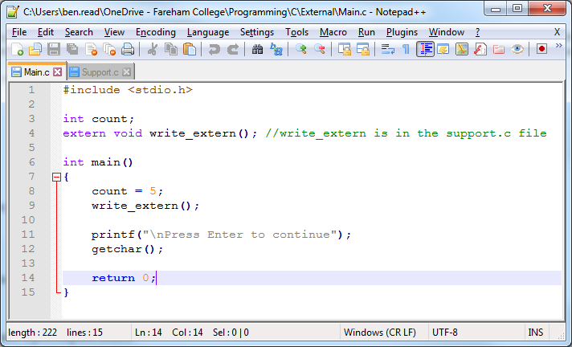
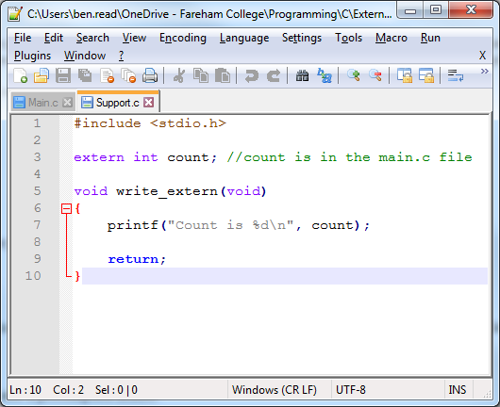
MODULARITY

Slide 7
PROGRAMMING LIBRARIES
C contains a set of modules known as the C Standard Library. The C Standard Library is a set of built-in functions, variable types and header files like <stdio.h>, <stdlib.h>, <math.h>, etc.
There are many, many features incorporated in these libraries which can be easily accessed by including the required library in your program. You can do this by utilising an #include statement, e.g.
#include <stdio.h>

Slide 8
PROGRAMMING LIBRARIES
Please visit https://www.tutorialspoint.com/c_standard_library/
This is an excellent resource which lists and explains all of the libraries, pre-defined functions, and macros, etc., in C and how you can utilise them in your programs. I advise you to bookmark it for future reference.

Slide 9
PRE-DEFINED FUNCTIONS
Pre-defined functions are functions that are either built into the standard libraries or have been created by somebody else. They are readily available, either as part of your compiler installation or online, and can be re-used in your code as many times as you wish.
They are defined in header files which must be included in your code in order for them to be accessible, e.g. printf(), scanf(), getchar(), etc. Most of the standard pre-defined functions are included in stdio.h which is why all the programs you’ve written so far have included this library’s header file on the first line of the program.

Slide 10
EXAMPLE: PRINTF()
Description:
The C library function int printf(const char *format, ...) sends formatted output to stdout.
Declaration:
Following is the declaration for printf() function.
int printf(const char *format, ...)
Parameters:
format − This is the string that contains the text to be written to stdout. It can optionally contain embedded format tags that are replaced by the values specified in subsequent additional arguments and formatted as requested. Format tags prototype is %[flags][width][.precision][length]specifier.

